Slide 1
Detecting Covid-19 Misinformation on Social Media
Student: JASON MICHAUD, Bryant University
jmichaud1@bryant.edu, 774-504-0390
Mentor: DR. SUHONG LI, Bryant University
sli@bryant.edu
Project Owner: DR. GAURAV KHANNA, University of Rhode Island gkhanna@uri.edu
11/09/2022

Slide 2
Understanding Covid-19 Pandemic through Social Media Discussion
Prior project done by Brenna Rojek
Study based on 1.2 billion COVID-19 Tweets collected since March 2020
Using the Huggingface Carddiff NLP emotion model to extract emotion, anger and sadness were found to be dominant.
Since August 2021, anger has risen towards the discussion of the COVID-19 vaccine
Notes:
joy, optimism, sadness, and anger

Slide 3
Previous Research
Cross-Country Analysis of the Psychological Impact of the COVID-19 Pandemic Through Social Media
Twitter study done for understanding the effects of the COVID-19 pandemic on the mental health of the general public.
Text analysis and retweet networks among methods used
Significant impact in India and
United States could be seen
Notes:
Visuals?

Slide 4
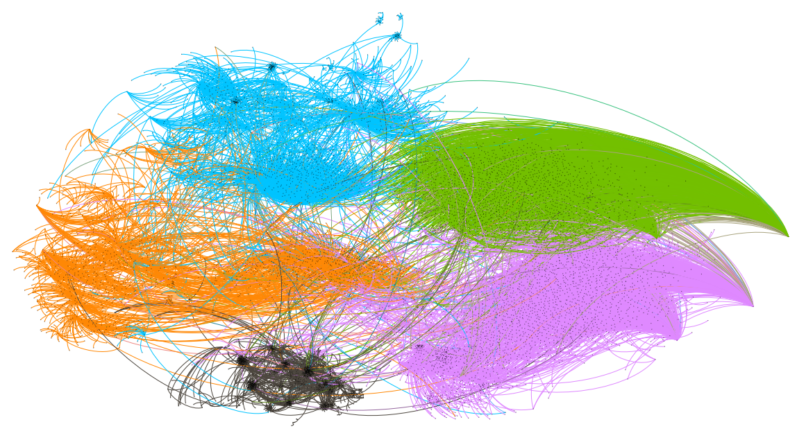
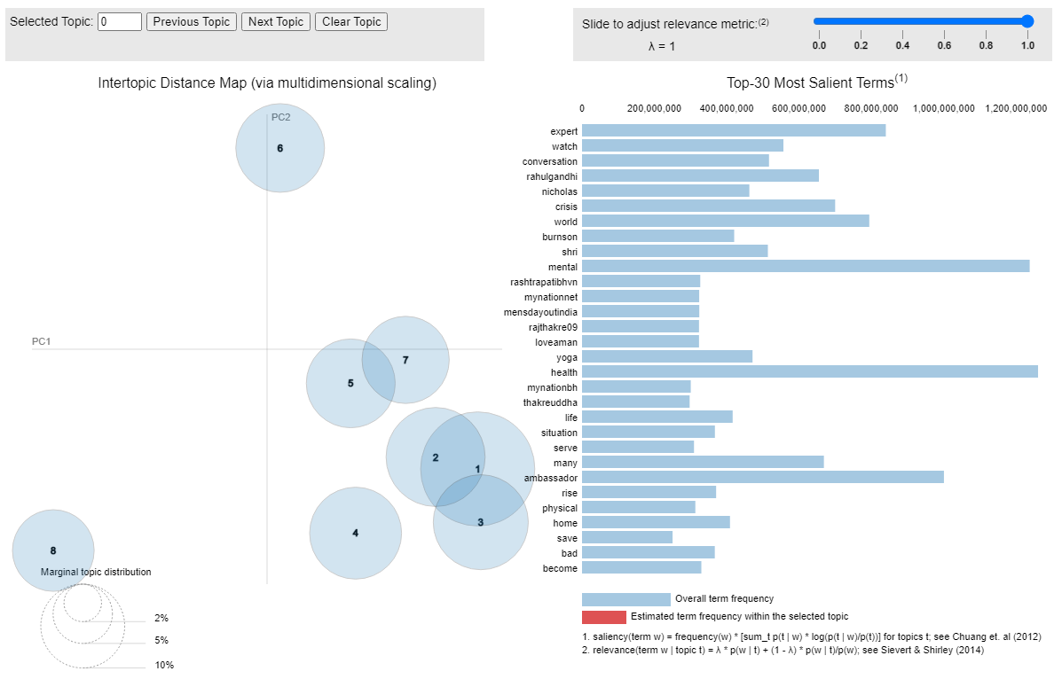
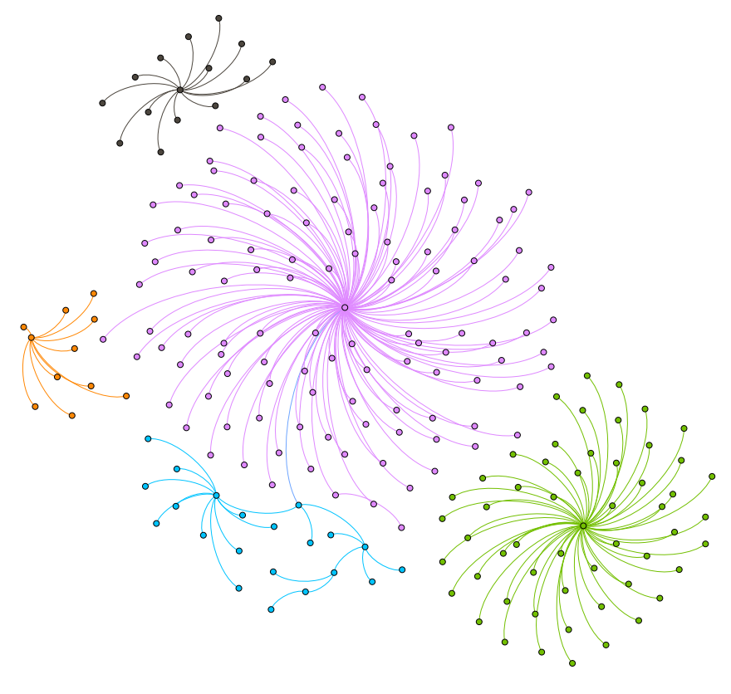
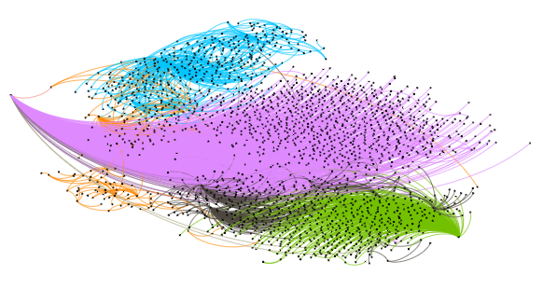
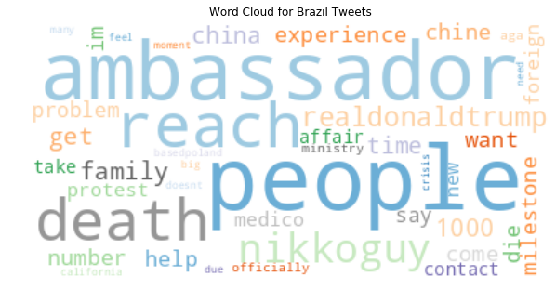
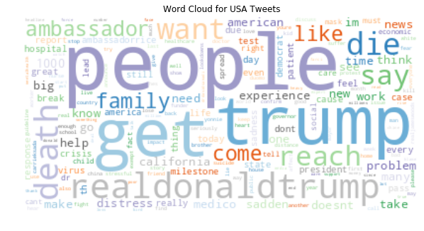
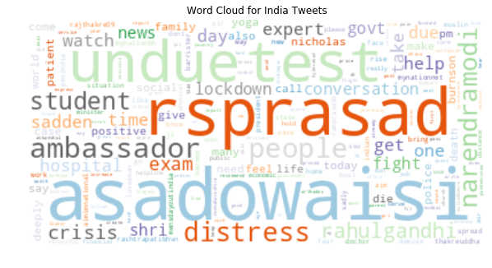
ANALYZING THE PSYCHOLOGICAL IMPACT OF THE COVID-19 PANDEMIC THROUGH SOCIAL MEDIA
Jason Michaud
Center for Health and Behavioral Sciences, Bryant University, Smithfield, RI;
Background and Basic Analysis of Tweets
Influential User Analysis
Analysis of Subtopics In Tweets
COVID-19 has been a worldwide issue for almost two years, and unknown areas have led to a large psychological impact on the population of the world.
The countries that were focused on in this project include India, Brazil, and The United States. These three countries are all in the top three for both COVID-19 cases and deaths.
A dataset of over 1 billion Tweets was reduced to three smaller datasets for each country. Mental health keywords and user locations were used as filters.
The United States contained 322,297 Tweets, Brazil contained 6,565 Tweets, and India contained 256,017 Tweets.
Analysis was performed in Databricks on these Tweets to identify underlying topics, and influential users. Data was also visualized in this tool to obtain some overall insights.
Gephi was utilized to aid in this user analysis in terms of visualizing the user network.
India Network
Brazil Network
India Topic Modeling
Important Topics Table
Country | Topic | Key Aspects
India | Asaduddin Owaisi | fight, pain, demise, regret, hospital, death, doctor, nurse, bad, hard, free, punish, arrest, shamelessness, distress, student, and crisis.
India | Mental Health Coping | sadden, helpline, combat, yoga, church, orthodox, and deal
United States | Effects of the Pandemic | death, family, sadness, pandemic, die, spread, heavy, and heart
United States | Mental Health and Related Areas | abuse, addiction, symptom, dangerous, suicide, dead, die, brother, friend, pain, alcoholism, and distress
Brazil | Frustration | crisis, help, medico, due, die, problem
United States Network
Figure 2 above shows the three graph networks that were ran in Gephi for this project. Each one of these has influential users that are key to the spread of information. Modularity class is what determined the color, and this essentially divides the networks into clusters.
Brazil- The pink subnetwork in Brazil is headed by @AmbassadorTai. This is Katherine Tai, and she is a USA Trade representative. Her influence in this dataset comes from her making headlines in March for getting the intellectual property rules waived for the COVID-19 vaccine.
India- For India, there are a few influential users. For the green subnetwork, that user is @asadowaisi. This is Asaduddin Owaisi, and he is the president of AIMIM and a member of Parliament. His influence stems from many Tweeting at him about mental health.
United States- The pink subnetwork for The United States is headed by @AmbassadorTai like that of the Brazil Network. Again, she showed up for her part in waiving the intellectual property rules of the COVID-19 vaccine.
Prior to running the LDA (latent Dirichlet allocation) model shown above in Figure 3, the text from the Tweets was preprocessed. Stop words were removed and words were reverted to their stem. Initial keywords to filter the datasets and country names were also removed from the Tweets. Although Figure 3 only shows the topic modeling for India, this model was run for each country and the relevant topics can be found in Table 1.
Figure 1 above shows three word clouds for each country’s dataset. A word cloud includes the words that show up with the highest frequency in all Tweets. With each dataset being about mental health, those keywords were removed.

Slide 5
Introduction
Study based on over 1.5 billion COVID-19 Tweets collected since March 2020
Fake news is an area of interest with Twitter data, ML studies exist in this domain.
Main goal is to predict fake news related to COVID-19 while also understanding how it spreads, what the topics are, and who is important
Analysis to be done in Databricks and models to be run in HPC environment
Notes:
Introduction/Motivation for project
Based on literature and what we know
Literature review and why it is significant
Why fake news is impactful

Slide 6
Detecting Covid-19 Misinformation on Social Media
Goals
Develop and validate a machine learning model to predict COVID-19 misinformation for the USA, India, and UK.
Uncover how COVID-19 misinformation spreads through social media, and who is spreading it.
Deepening understanding of text-based machine learning techniques
Notes:
Narrow down more

Slide 7
Detecting Covid-19 Misinformation on Social Media
Timeframe
Initial Research
Literature review and technology (NLP and ML)
Start to learn HPC
November 2022
Dataset Creation
December 2022
Analysis and Building models
Continue to familiarize with HPC
January 2023
Refining Models and Writing Paper
February 2023
Present and Submit for Publication
March 2023
Notes:
Put Milestones with dates
- Use participation letter to develop this slide

Slide 8
Detecting Covid-19 Misinformation on Social Media
What I hope to learn
How to appropriately use a high-performance cluster
New machine learning and NLP techniques
How COVID-19 Misinformation spreads on social media

Slide 9
Detecting Covid-19 Misinformation on Social Media
Goals for Next Month
Refining a dataset for the United States, India, and United Kingdom based on location keywords
Starting to analyze each dataset once filtered down in Databricks through various methods such as visualization and topic modeling

Slide 10
Questions?

