Slide 1
Discovering the Structure, Function, and Evolution of Sirtuins and Associated Proteins in Aiptasia: A Deep Learning and Integrative Genomics Approach
Student: Samantha Kidwell, Wilmington University, skidwell001@my.wilmu.edu
Mentor: Dr. Milton Muldrow, Wilmington University, Milton.x.Muldrow@wilmu.edu
Researcher: Dr. Milton Muldrow, Wilmington University, Milton.x.Muldrow@wilmu.edu
Date: 11/13/2024

Slide 2
Discovering the Structure, Function, and Evolution of Sirtuins and Associated Proteins in Aiptasia: A Deep Learning and Integrative Genomics Approach
Coral bleaching has been an increasing concern since 2014 when the Great Barrier Reef started showing signs.
With consistent rising temperatures due to global warming, it is becoming more difficult for the coral to adapt.
Using a model organism with similar DNA to coral, Aiptasia Pallida, a sea anemone, allows us to investigate the proteins associated with coral bleaching.

Slide 3
Goals
Utilize fully sequenced Aiptasia genome to:
Examine potential protein interactions, (i.e., NAD+) using AlphaFold and ColabFold.
Compare protein functional sites across taxa (i.e., active and binding sites) to develop hypotheses regarding function.
Utilize DARWIN high performance computing system for the integrative analysis of structural, functional, and evolutionary data.

Slide 4
Discovering the Structure, Function, and Evolution of Sirtuins and Associated Proteins in Aiptasia: A Deep Learning and Integrative Genomics Approach
Timeframe
  January 2024
  October 2024

Slide 5
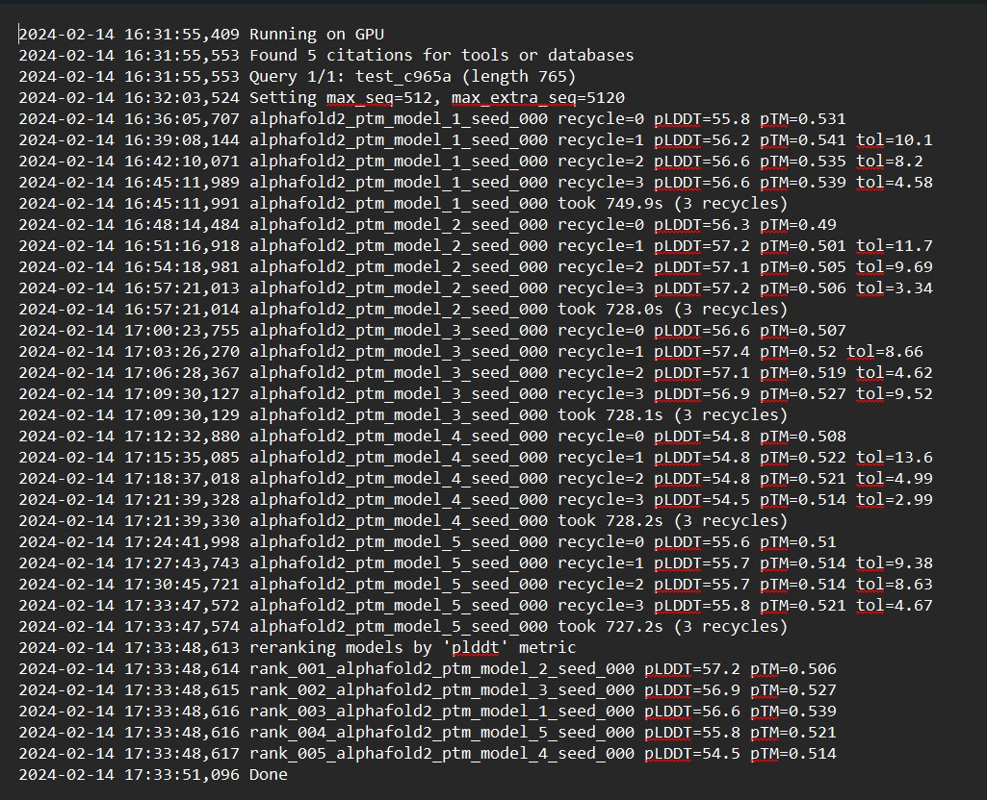
What we accomplished
Used our sequenced Aiptasia genome from the lab to take a more detailed look into the structure and function of Sirtuin proteins using AlphaFold/ColabFold
Used DARWIN to determine AlphaFold/ ColabFold accuracy in predicting protein structure and potential binding sites
Used ChimeraX to create a visualization of the sirtuin protein sequence of Aiptasia and compared to human sirtuin proteins

Slide 6
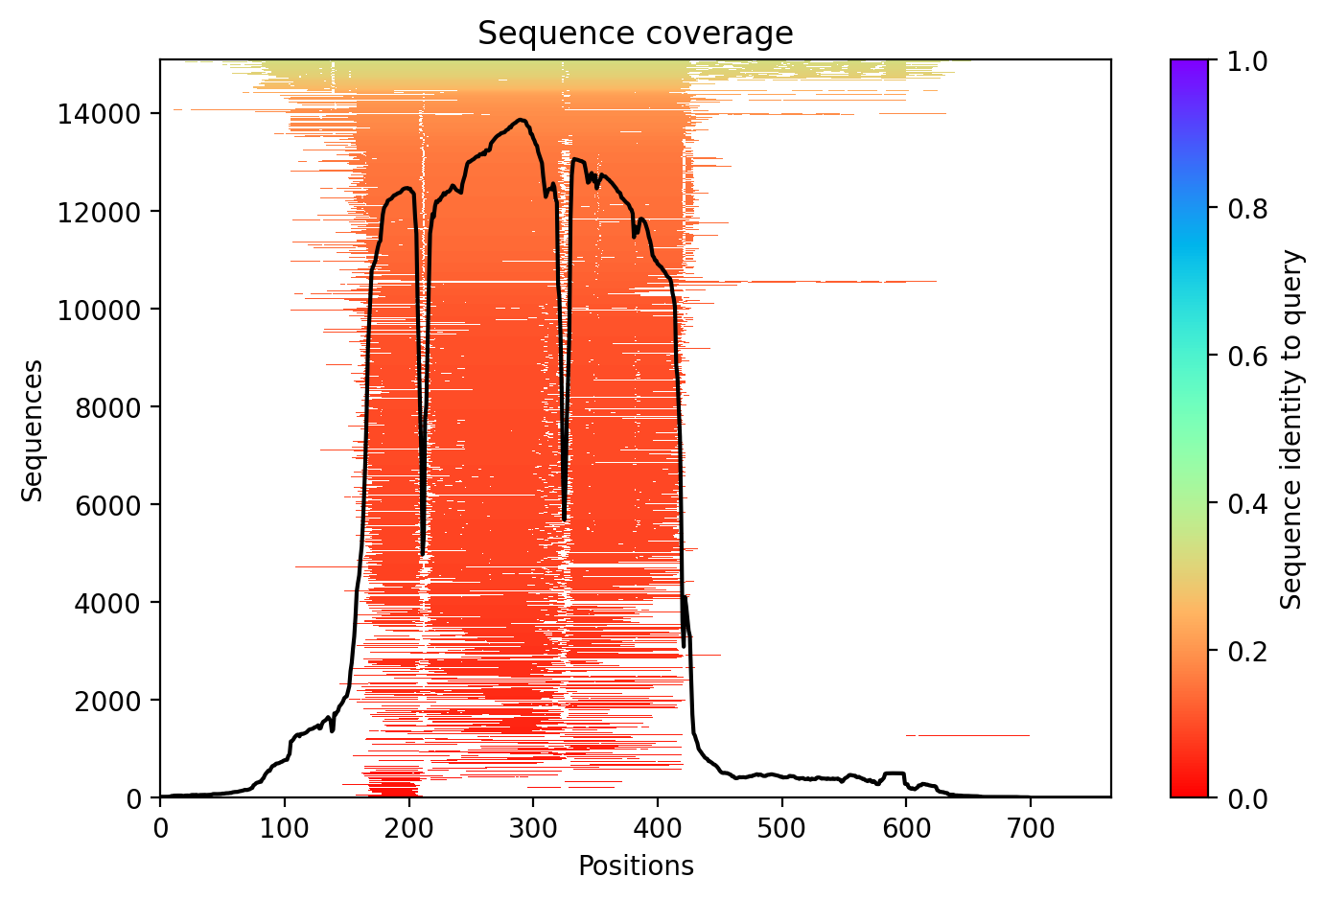
What we accomplished
Aiptasia Pallida Sirtuin 1:
Sequence coverage graph shows the number of aligned sequences at each position of the protein.
There are up to 700 amino acids that are identified for Sirtuin 1 with AlphaFold/ColabFold using our Aiptasia sequence

Slide 7
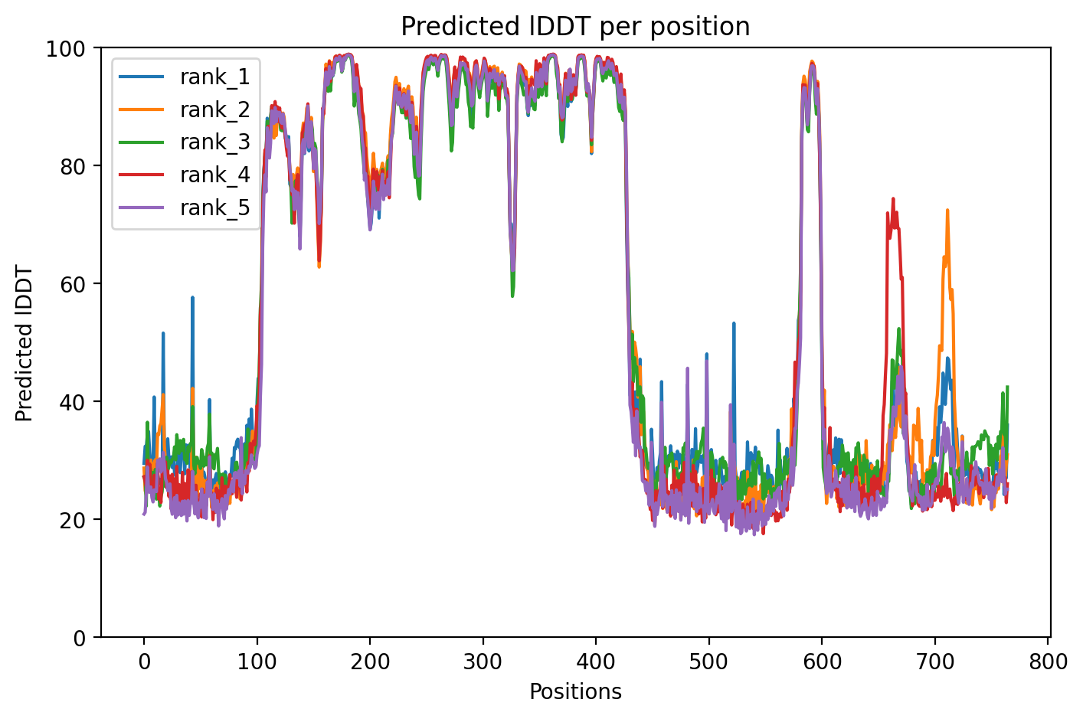
What we accomplished
Aiptasia Pallida Sirtuin 1 Alphafold:
The running environment used a GPU, which enhanced the computational efficiency.
A maximum sequence length of 512 was set, and an additional 5120 for extra sequences during query processing.
The metrics evaluated for each model include pLDDT (predicted Local Distance Difference Test) and pTM (predicted Template Modeling score), which are used for determining model accuracy and reliability.
The total computation time for recycling across different models varied, averaging around 728 seconds.
"relax tolerance“ was set at 2.39, defining the threshold for an acceptable level of relaxation during the computations of the protein sequences

Slide 8
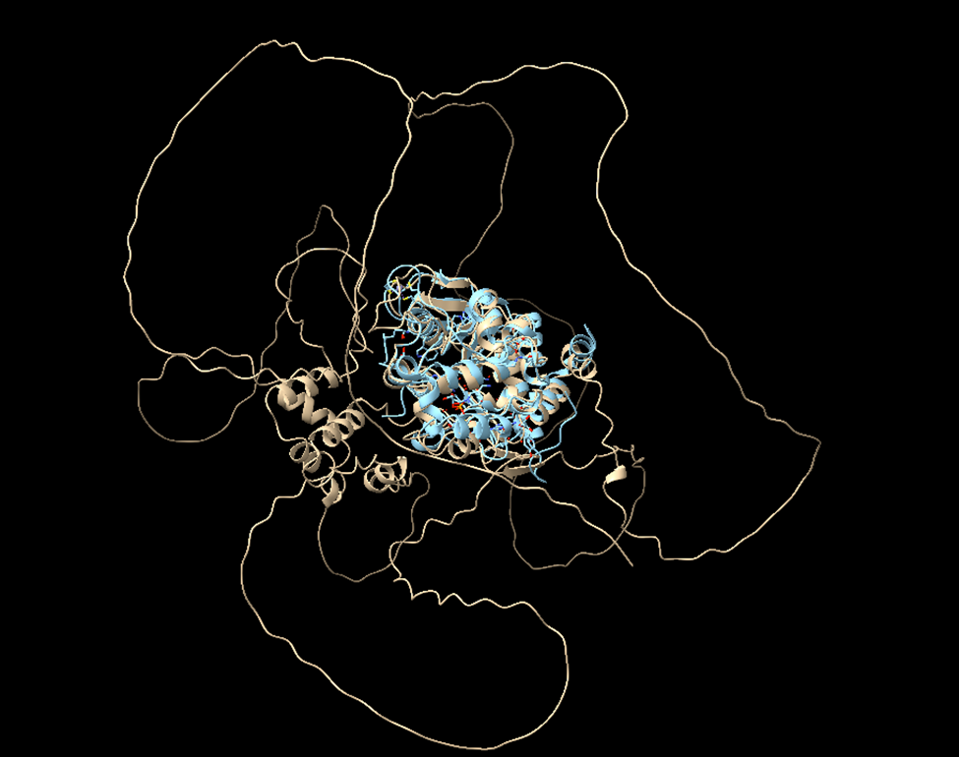
What we accomplished
Aiptasia Pallida Sirtuin 1 Comparison:
Use DARWIN to confirm AlphaFold/ColabFold accuracy
Compared Aiptasia sirtuin sample to human sirtuin samples
Using ChimeraX to visualize the similarities and differences.
Out of 268 atom pairs, 179 atom pairs align with human sirtuin 1

Slide 9
Lessons Learned
What went well?
  Using our sequences from the lab to have more accurate information to run through AlphaFold and ColabFold
  Using programs such as ChimeraX to visualize the protein and try to fit it with known Sirtuin proteins in human DNA
  Utilizing DARWIN to check our information
What could have been done differently?
  Having a separate account for AlphaFold/ColabFold
  Providing more storage for results

Slide 10
Publications/Contributions
None at this time

Slide 11
Contributions to Research Computing Community
(Please include links and topics!)
Knowledge Base Contributions
  Ask.CI contributions
    https://ask.CI
  CI Links contributions
    https://careers-ct.cyberinfrastructure.org/knowledge-base/ci-links
Github contributions
    https://github.com/necyberteam
Other?

Slide 12
Acknowledgements
Daniel Chauss
Dr. Muldrow
Anita Schwartz
CAREERS

